Slide 1
Java 8 – SE 1 Presentation
Chapter 3 – Core Java APIs

Slide 2
- Explain how to create a String ? (2 ways)
- What is String concatenation ?
- Explain String concatenation with compound assignment operator ?
– Explain String immutability
– Explain what is String pool ? (and state the other name of String pool ?) (code illustration snippet 1 – 2 – 3 – 4 - 5)
- Explain about these important String method:
length()
charAt()
indexOf()
substring()
toLowerCase() and toUpperCase() (code illustration snippet 6)

Slide 3
equals() and equalsIgnoreCase()
startsWith() and endsWith() (code illustration snippet 7)
contains()
replace() (code illustration snippet 8)
trim()
- Explain what is method chaining in String ? (code illustration snippet 9 - 10)

Slide 4
Using StringBuilder class
(code illustration snippet 11)
- The example that we just looked through has created a total of ... String Object => ...
– Therefore, we have to use something new => we use StringBuilder
- The reason why String is far more ... than StringBuilder is because of its ... (in fact, it also has a ..., but it has ... keyword => they cant be ...)
– StringBuilder on the other hand, has a ... of ... inside it => and it's ...able => Each time when we mutate the StringBuilder object, it will ... the ... inside the object and return ...
(code illustration snippet 12)
- There are ... constructors available to create a StringBuilder object
+) StringBuilder(?)
+) StringBuilder(?)
+) StringBuilder(?)
– By using the default no-arg constructor, Java will initiate the ... inside StringBuilder object with a default capacity of ...
- Explain the difference between size and capacity

Slide 5
Using StringBuilder class
- Important StringBuilder method:
charAt()
indexOf()
length()
substring() (what does this return ?)
append()
insert()
delete()

Slide 6
Using StringBuilder class
deleteCharAt()
reverse()
toString()
- The reason why we still need toString() is that we only need the ... of the StringBuilder and the final result we need is only ...

Slide 7
- Explain about equality ?

Slide 8
Understanding Java Array
- What is array ?
– Illustrate different types of array declarations and initialization
Note: Directly initialize an array without specifying its ... and ... are called "..." method. They are called "..." because the ... and ... are unknown
- Array can also used with casting, however, it is only applicable to ... type not ... type (code illustration snippet 13 – 14)
- Elements inside the array can also apply casting or ...
NOTE: Array casting can only be done on ... and must be from ... types to ... types !. The reason is because an array with ... types could contains ... => when casting to ..., Java doesn't know that the array with ... types ... => it won't let us do it
- Explain how to use an array ? (access element, looping, ...)
– To sort an array, we can use a method from ... class called "..."
- Array.sort() is a ... method, this allows us to ... multiples ... for sorting
(code illustration snippet 14 – 15)
- In snippet 15, we are sorting String => Java will use ... table for ...
– In array, we can also ... for element by using ... algorithm (in other word, use ... method)
- A key condition to use ... properly is that the Array must be ... or else the result could be ...
– If an element is found => ?, if an element is not found (assume that the array is ...) => ? (code illustration snippet 16 – 17)

Slide 9
Understanding Java Array
- Explain about multidimensional array ?
- Explain different ways to create a multidimensional array ?
- A multidimensional array could be either symmetric or ... ? => when declaring an ... multidimensional array, ... isn't required
(code illustration snippet 18)
- When using the above method, the ... dimension will be ... => if the ... of other dimension are not ... => all values will be ... to ... values
(code illustration snippet 19 - 20)
- When using enhanced loop with array for ... type, the ... variable could be ... or ... but it can't be ... of the ... itself (this also applies to ... type)
- This is because with reference types, the compiler detects whether the types are ... with the types that we ... => it will auto...
(code illustration snippet 21)

Slide 10
Understanding an ArrayList
- Explain what is ArrayList ?
- How many ways to create an ArrayList ? (list 3 types of ArrayList constructor)
- When we looking at the ArrayList class, we can see the ... letter appears on some methods or constructor. The letter ... is not a ... but it is just a ... => the letter will change depend on ..., if no ... are detected => ... will become Object class
– What specials about the 3rd constructor ?
- Explain these important ArrayList method:
add()
boolean remove(Object object)
E remove(index)
E set(int index, E newElement)
isEmpty() and size()

Slide 11
Understanding an ArrayList
clear()
contains()
equals()

Slide 12
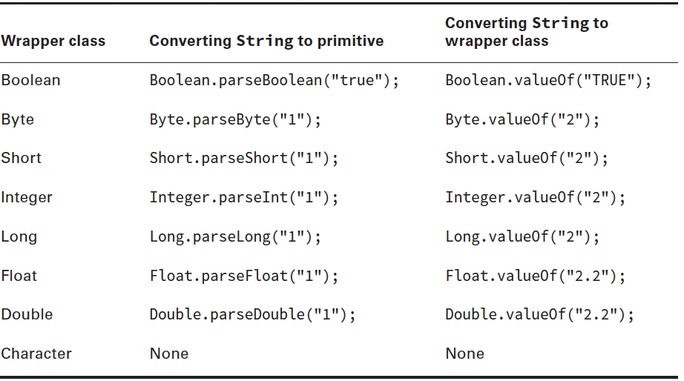
Understanding Wrapper classes
- Explain what is wrapper object ?
- Wrapper classes has ... methods allows us to change a ... to ... or ... => These method are called ...() and ...()
– parseInt() is used to change from .... to ...
– valueOf() is used to change from ... to ...
- All wrappers classes ... this methods

Slide 13
Understanding Wrapper classes
- Explain what is autoboxing ? (Also explain autoboxing in ArrayList)
(code illustration 22 - 23)

Slide 14
Converting between Array and List
- To convert from list to array, we use a method called ...()
- There are 3 cases happen when using this method
+) Case 1: ...
+) Case 2: ...
+) Case 3: ...
(code illustration snippet 24 – 25 – 26)
(make sure to ask question about asList method, Q2 – 3)

Slide 15
Sorting ArrayList
- To sort an ArrayList, we use a method called ... from ... class
(this method is .... and the version we use doesn't have ... parameter)
(code illustration snippet 27)

Slide 16
Working with Dates and Times
- In Java 8, Oracle has completely ...
- Just like Arrays class, we have to ... it by using ...
Note: The exam doesn't require us to study about time zone => no need to cover that
- Java gives us ... ways to work with dates and times (this depends on ...)
+) Local...
+) Local...
+) Local...
(the word "local" indicates that we are working with ....)
- Oracle also recommends that we should only work with ... when needed
(code illustration snippet 28)
- All 3 classes has a ... method called "now()" that ...
- The format of ... are written in the format ...-...-... and the time are in ... hours format
– To create 3 locals object with ... data, we use a ... method from 3 classed called "..."
(code illustration snippet 29)
NOTE: Java always count from ..., however, when working with dates and time, there is 1 exception, which is ...

Slide 17
Working with Dates and Times
- When working with time, we can choose ... => we could ... as many as we want (requirement: must contains ... and ... in the object)
(code illustration snippet 30)
- We can also combine the ... and ... into single object by using Local...
– There are ... constructors available for LocalDateTime (Java APIs illustration + snippet 31)
- The only ways to ... objects is by using ..., not ...
– This is because the ... of 3 classes are all set at ... modifier
- Also, the 3 classes also check our ... => If we pass ... => exception
NOTE: The class only checks for ... and ... to see if they are ... or not. However, with ... parameter, we can pass ... (e.g, if we pass 0 => ?). This happen because Java exclusively count ... only when working with date and time (if we pass < 0 => ?)

Slide 18
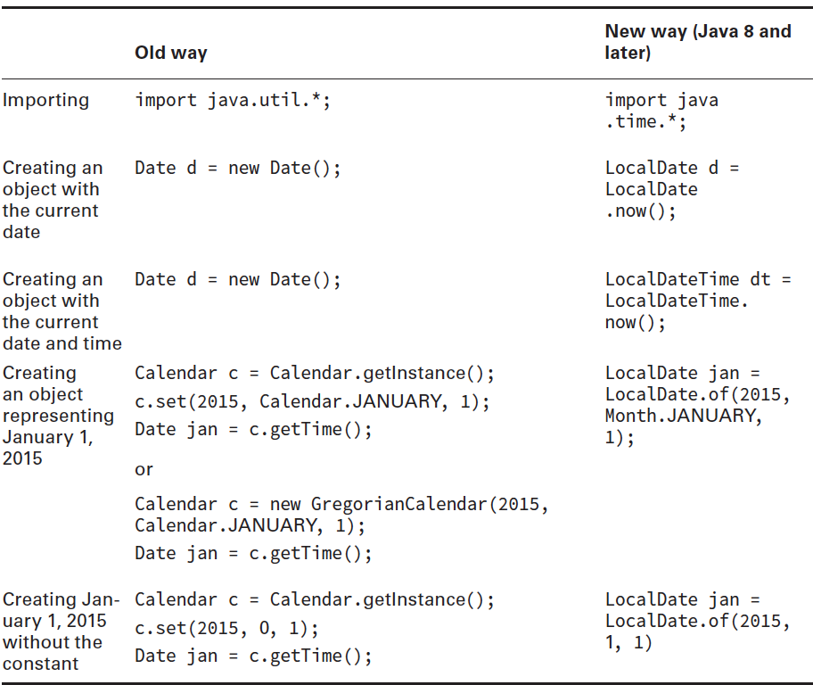
Working with Dates and Times

Slide 19
Working with Dates and Times – manipulating date and times
- We can also change ... of the ... object. However, like String class, ... objects are ... => When we change ... of the object, its ... new ... to another object
- This requires us to ... the object by ... it to a ... variable
(code illustration snippet 32 – 33)
- Method ... can also be applied to date-time manipulation
(code illustration snippet 34 – 35)
- We must be careful that some methods are ... on some classes while ...
(code illustration snippet 36)

Slide 20
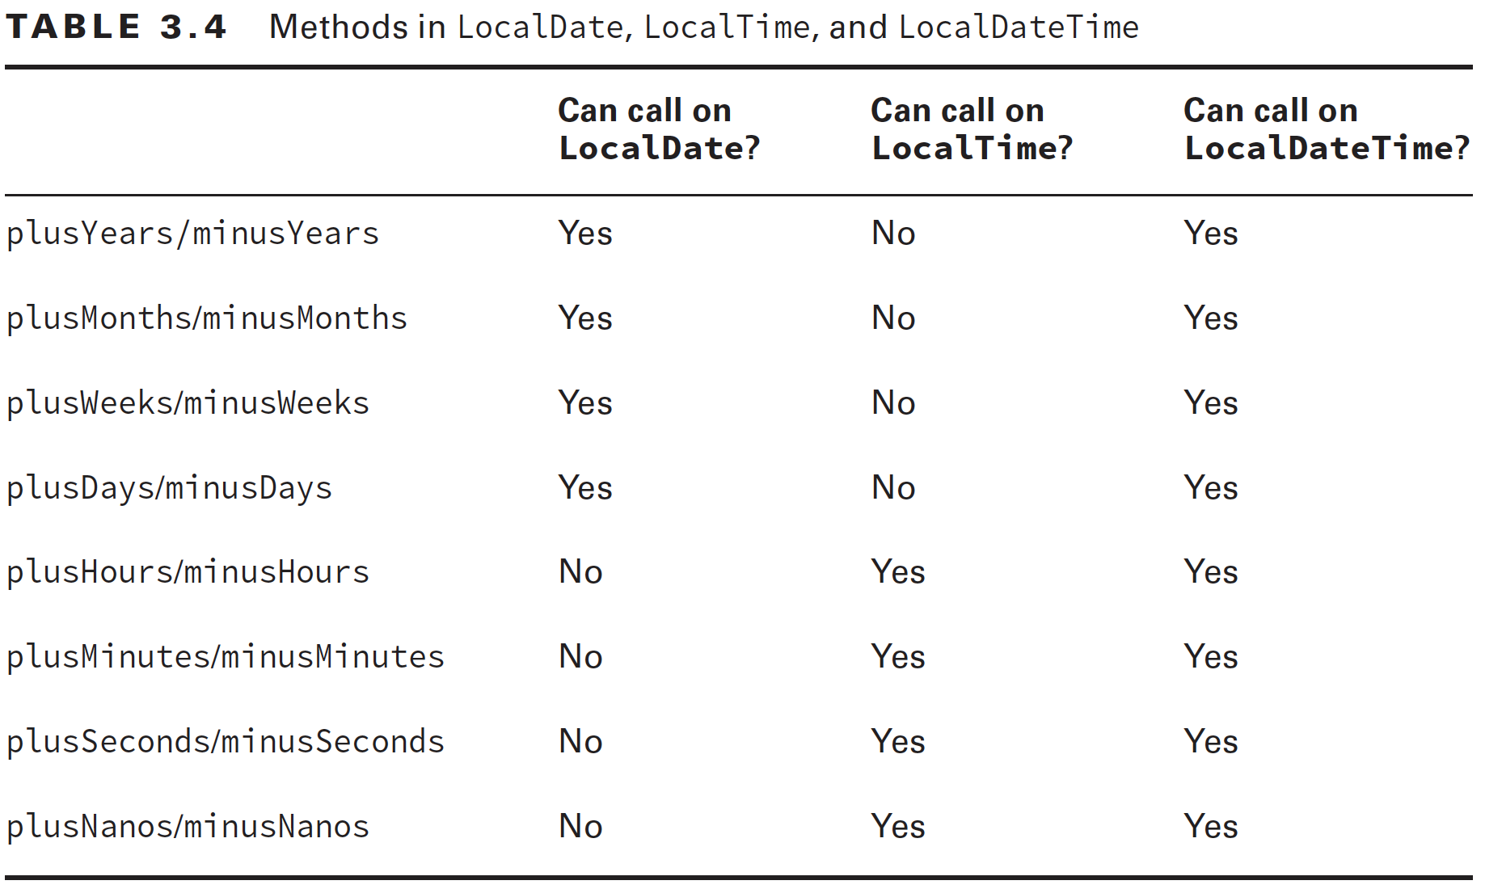
Working with Dates and Times – manipulating date and times

Slide 21
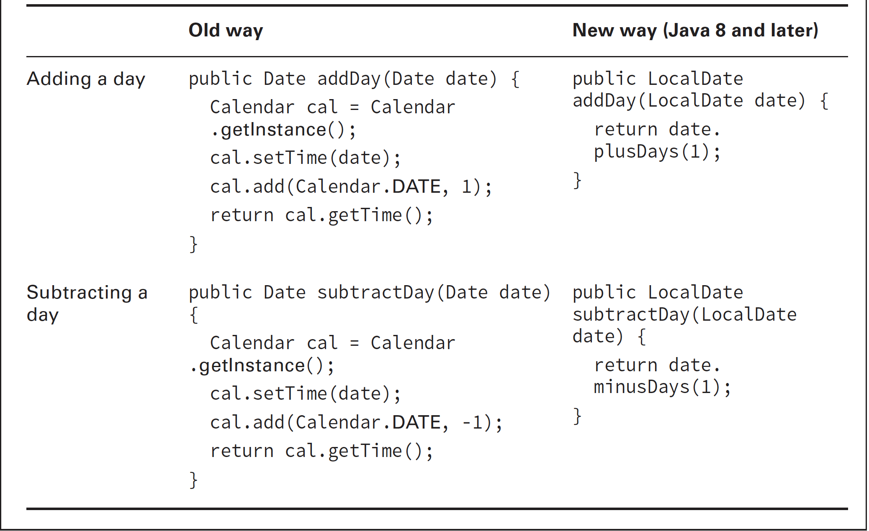
Working with Dates and Times – manipulating date and times

Slide 22
Working with Dates and Times – manipulating date and times
- Assume that we have a method: (code illustration snippet 37)
- The problem with this method arise when it comes to reusability
- To fix this problem, Java has provided to us a special class called "..."
- We can combine this class with a method called "..." to ... the method
(code illustration snippet 38)
- There are ... ways to create Period object:
+)
+)
+)
+)
+)

Slide 23
Working with Dates and Times – manipulating date and times
- The last ways is a bit special when compared to the following code
(code illustrations snippet 39 and compare it with snippet 40)
- The codes that we just illustrated are all .... However, if our intentions are creating a Period object with data of ... and ... => this code still ...
=> Period class provide us with a method called "..." (illustrated in last section)
- When we working with Period, we are working with ... datatype ( >= ?). To work with ... datatype, Java provides us "...", which used to work with ... datatype (<= ?)
(code illustration snippet 41)
Fact: There is a method called "..." in Local... and "..." in Local..., which count the ... and ... from 00:00:00 1-1-1970. Why this date is so special ?, it is because that this is called ...
Unix time is the standard for ... to measure ... and it is applied since ...
It use ... integer, which will reach to its ... in 20?? and cause ...

Slide 24
Working with Dates and Times – Formatting dates and times
- All date – time classes allow us to ... the data out of the ...
(code illustration snippet 42)
- However, trying to ... these informations with the illustrated code is too ... => Java provided a class called ..., which helps us ... the data more easily
(code illustration snippet 43)
- If you still uncomfortable with ISO format, Java also provides other ways to ...
(code illustration snippet 44)
- In the illustrated code, ... has a method called "...", where will pass a ... as a parameter => ...
– For LocalTime, the only parameter that it accept is ... and ...
– For LocalDate, all parameters are ...
+) ... parameter: The format is ...
+) ... parameter: The format is ...
+) ... parameter: The format is ...
+) ... parameter: The format is ...

Slide 25
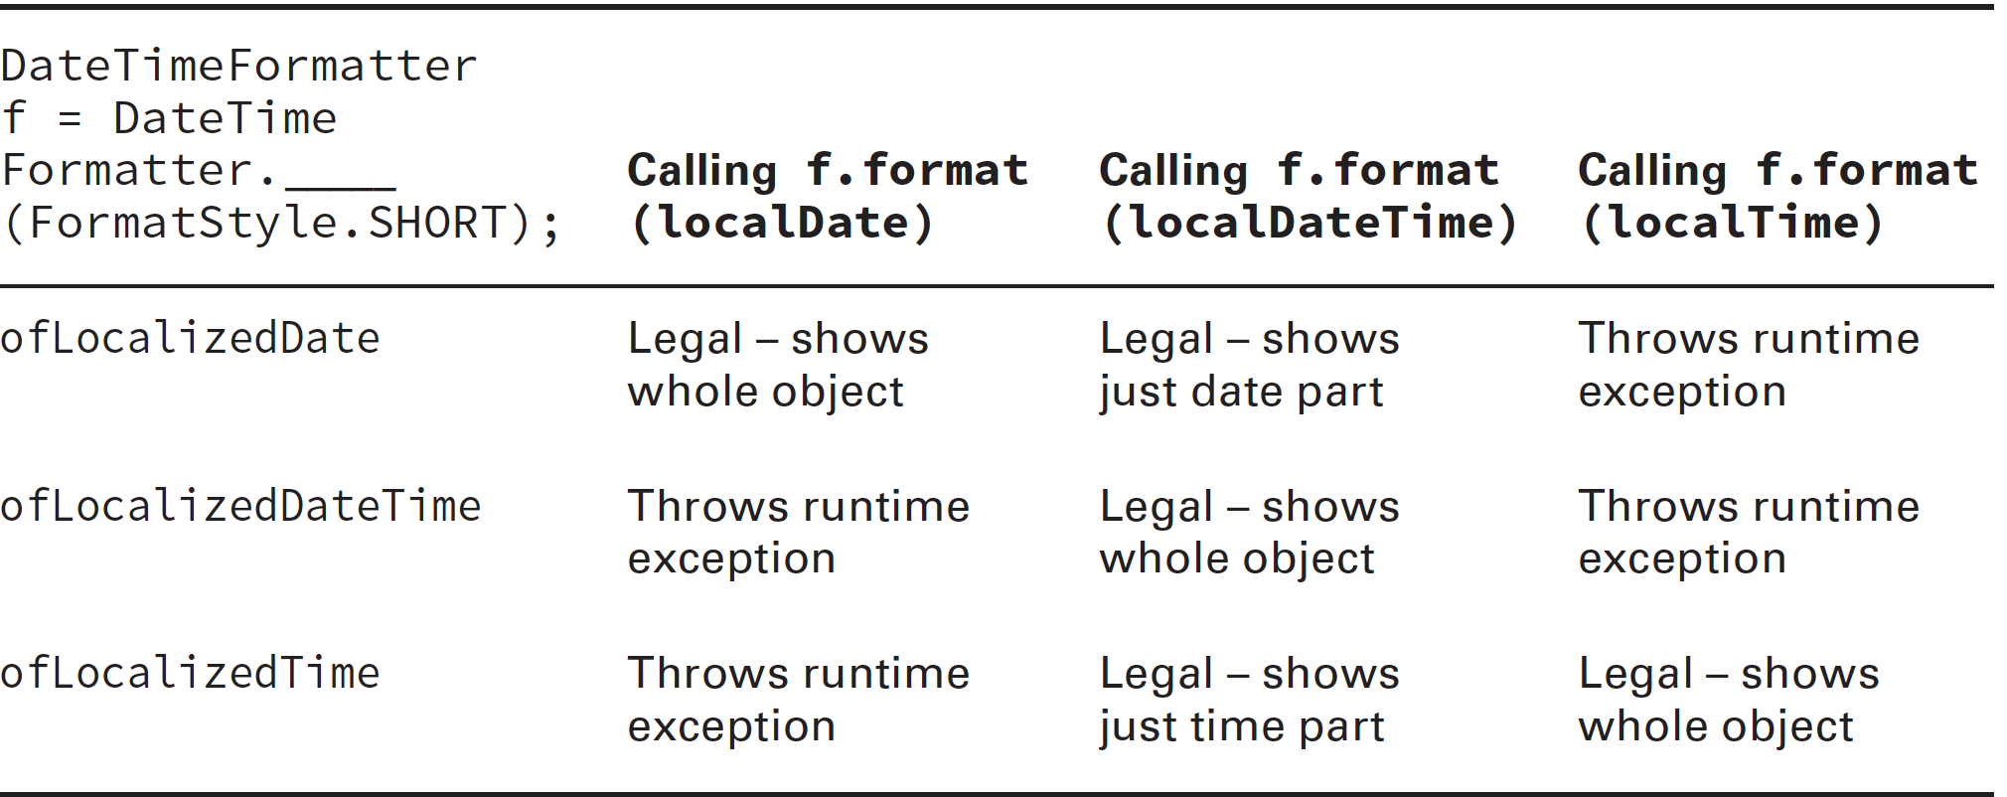







Working with Dates and Times – Formatting dates and times

Slide 26
Working with Dates and Times – Formatting dates and times
- All date – time classes allow us to ... the data out of the ...
(code illustration snippet 42)
- However, trying to ... these informations with the illustrated code is too ... => Java provided a class called ..., which helps us ... the data more easily
(code illustration snippet 43)
- If you still uncomfortable with ISO format, Java also provides other ways to ...
(code illustration snippet 44)
- In the illustrated code, ... has a method called "...", where will pass a ... as a parameter => ...
– For LocalTime, the only parameter that it accept is ... and ...
– For LocalDate, all parameters are ...
+) ... parameter: The format is ...
+) ... parameter: The format is ...
+) ... parameter: The format is ...
+) ... parameter: The format is ...
- If you still hate these formats, Java also allows us to ... by using a special method called "..."

Slide 27
Working with Dates and Times – Formatting dates and times
- This method recieve a ... parameter, the ... must include these characters:
+) "m": ? (what special about this ?)
+) "d": ?
+) "y": ? (what special about this ?)
+) "h": ?
+) "m": ?
+) "s": ?
+) "n": ? (what special about this ?) (make sure to ask question about this, Q4)

Slide 28
Working with Dates and Times – Parsing Date / Time
- We can also convert String to ... by using ... method
(code illustration snippet 46)
- If we want to convert a string to Date-time object using our own ... => we need to create an ... object and pass it ...
– If we don't pass anything => Java will use ... format to convert our string to ... object (Note that the string should ...)

